Slide 1
Topologies

Slide 2
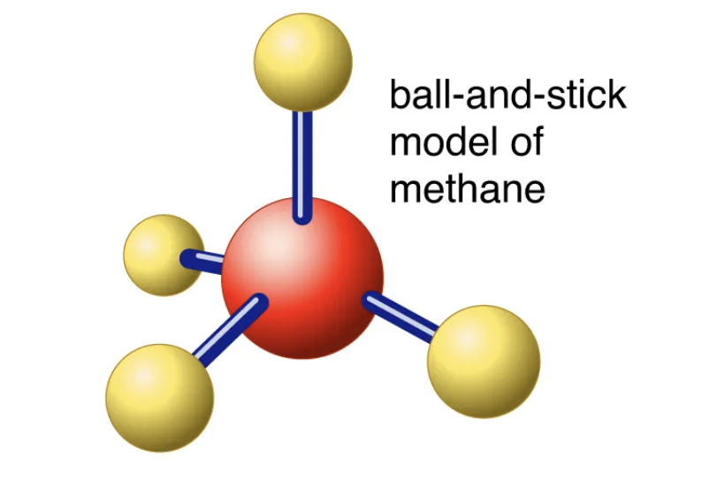
Molecular System Representation in MD
In Molecular Mechanics (MM) - based Molecular Dynamics (MD), any molecular system can be described as a collection of atoms and bonds connecting pairs of atoms.
To properly model the dynamic behaviour of molecular system, we need to know certain properties describing the atoms and bonds connecting them.

Slide 3
Atoms
In molecular dynamics simulations, an atom is typically represented by:
Position (x,y,z)
Velocity (Vx,Vy,Vz)
Mass (based on the atomic element)
Partial charge (electrostatics)
Element type (used for van der Waals parameters)
* These properties are used to compute forces and evolve the system over time using Newton's laws.

Slide 4
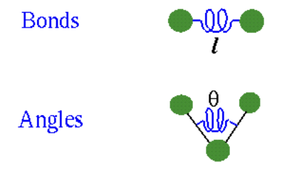
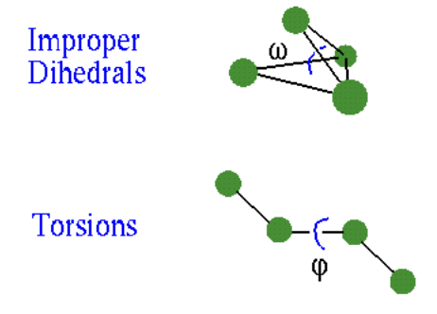
Bonds
In MD, bonds are modeled as springs: the bond energy depends on the bond length.
Angles and torsions define molecular geometry and flexibility.
Molecules (e.g., proteins) are represented as connected networks of atoms and bonds.

Slide 5
Forces and Forcefields

Slide 6
What is a forcefield?
Forcefield can be defined as a set of rules and parameters needed to run the MD. As we already learned, in MD we have atoms and bonds between them. Therefore, forcefield should describe:
Parameters of each atom
Parameters of bonds and angles between atoms
In OpenMM, forcefield is defined by .xml file with this data. You can find an example of amber-14 forcefield in data/ folder

Slide 7
What’s in a forcefield file?
We need to have the parameters for each atom and bond defined in structure file (pdb), but the forcefield is a fixed file, it isn’t specific for the strucutre. So how it works? The solution - MAP. Forcefield file can map the atoms from the structure file to some set of prameters.
The central concept here is the Residue Template.
Residue template maps the residues from pdb file to information about atom and bond parameters in the forcefield

Slide 8
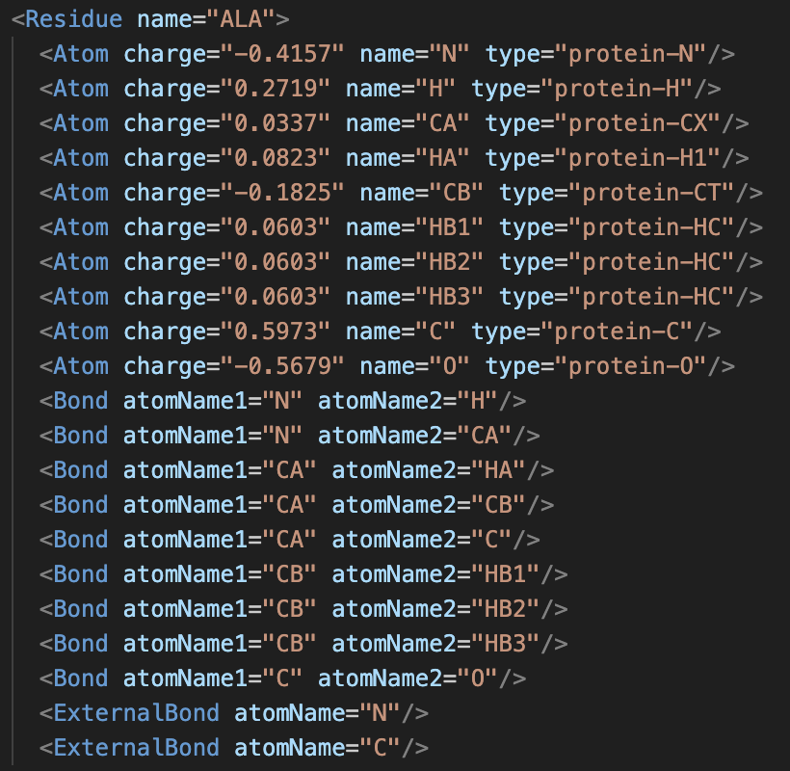
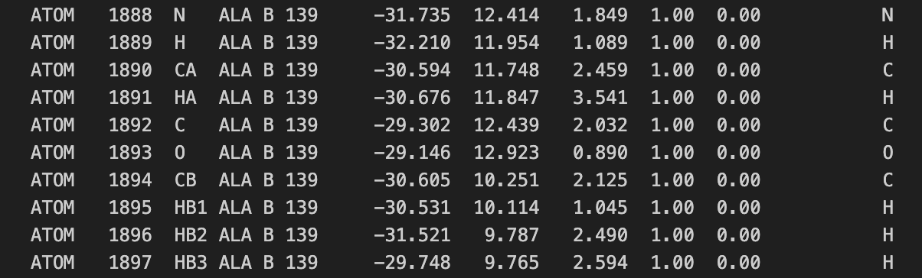
Residue Template vs Residue

Slide 9
Atom types
The atom type definitions look like this:
<AtomTypes>
<Type class="C" element="C" mass="12.01" name="protein-C"/>
<Type class="CA" element="C" mass="12.01" name="protein-CA"/>
<Type class="CB" element="C" mass="12.01" name="protein-CB"/>
<Type class="CC" element="C" mass="12.01" name="protein-CC"/>
There is one <Type> tag for each atom type. It specifies the name of the type, the name of the class it belongs to, the symbol for its element, and its mass in amu. The names are arbitrary strings: they need not be numbers, as in this example. The only requirement is that all types have unique names. The classes are also arbitrary strings, and in general will not be unique. Two types belong to the same class if they list the same value for the class attribute.
But these types have, like, only masses information …

Slide 10
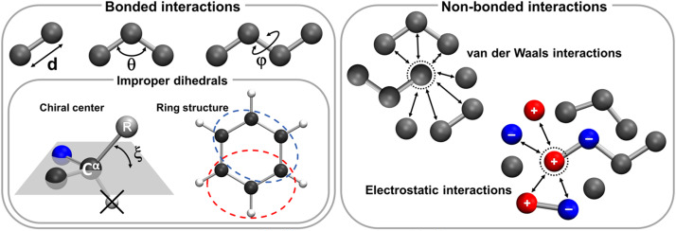
Bonded and Nonbonded forces

Slide 11
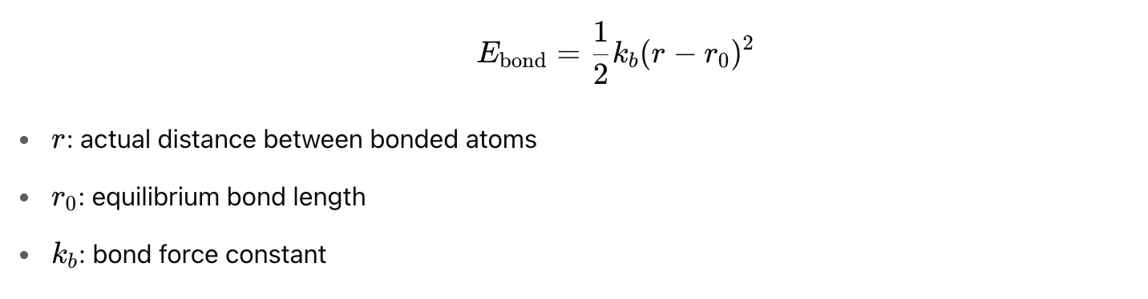
Bond Stretching (Harmonic Bond Force)
In OpenMM: <HarmonicBondForce>
<Bond k="259407.99999999994" length="0.1525" type1="protein-C" type2="protein-C"/>
<Bond k="392459.19999999995" length="0.1409" type1="protein-C" type2="protein-CA"/>
<Bond k="374049.5999999999" length="0.1419" type1="protein-C" type2="protein-CB"/>

Slide 12
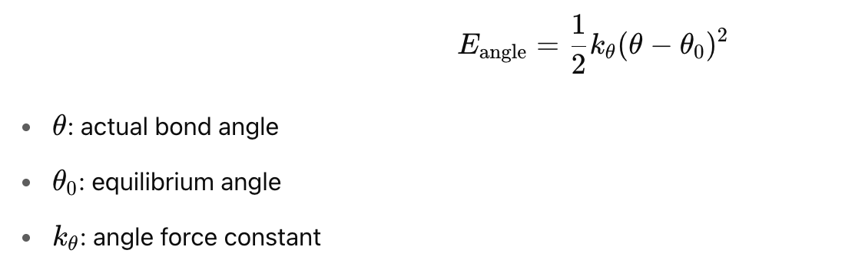
Angle Bending (Harmonic Angle Force)
In OpenMM: <HarmonicAngleForce>
<Angle angle="2.0943951023931953" k="669.44" type1="protein-C" type2="protein-C" type3="protein-O"/>
<Angle angle="2.0943951023931953" k="669.44" type1="protein-C" type2="protein-C" type3="protein-OH"/>
<Angle angle="2.0943951023931953" k="527.184" type1="protein-CA" type2="protein-C" type3="protein-CA"/>

Slide 13
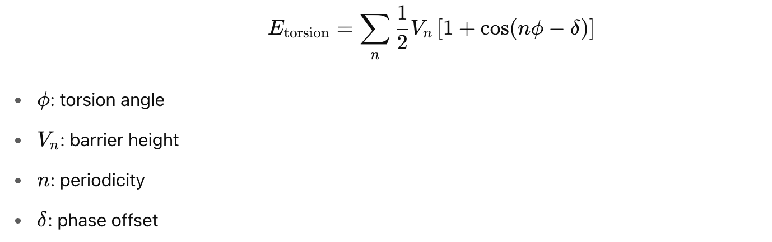
Torsional (Dihedral) Rotation and Improper Torsion (Planarity Restraint) (PeriodicTorsionForce)
In OpenMM:
<Proper k1="1.585736" k2="2.8534880000000005" k3="18.744320000000002" k4="1.75728" periodicity1="4" periodicity2="3" periodicity3="2" periodicity4="1" phase1="0.0" phase2="0.0" phase3="0.0" phase4="0.0" type1="protein-2C" type2="protein-S" type3="protein-S" type4="protein-2C"/>
<Improper k1="43.932" periodicity1="2" phase1="3.141592653589793" type1="protein-C" type2="" type3="" type4="protein-O"/>

Slide 14
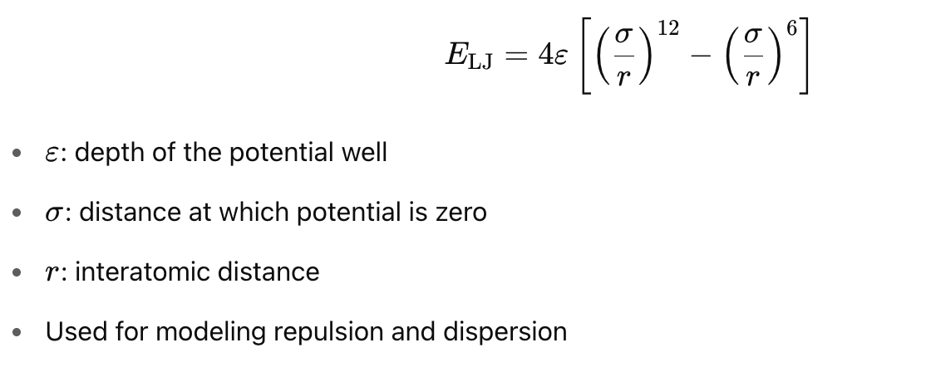
Non-Bonded: Lennard-Jones (van der Waals)
In OpenMM:
<NonbondedForce coulomb14scale="0.8333333333333334" lj14scale="0.5">
<UseAttributeFromResidue name="charge"/>
<Atom epsilon="0.359824" sigma="0.3399669508423535" type="protein-C"/>
<Atom epsilon="0.359824" sigma="0.3399669508423535" type="protein-CA"/>
<Atom epsilon="0.359824" sigma="0.3399669508423535" type="protein-CB"/>

Slide 15
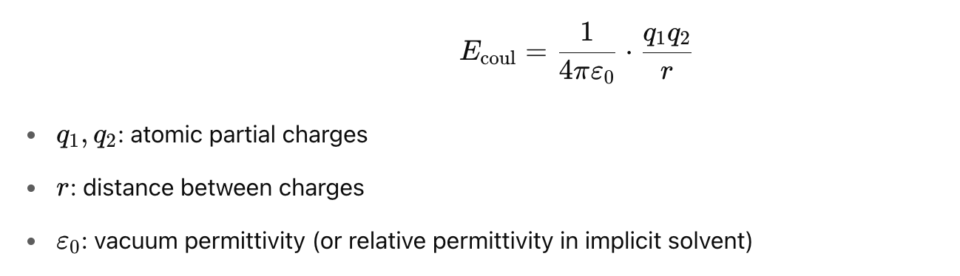
Non-Bonded: Coulomb (Electrostatics)
In OpenMM:
<NonbondedForce coulomb14scale="0.8333333333333334" lj14scale="0.5">
<UseAttributeFromResidue name="charge"/>
<Atom epsilon="0.359824" sigma="0.3399669508423535" type="protein-C"/>
<Atom epsilon="0.359824" sigma="0.3399669508423535" type="protein-CA"/>
<Atom epsilon="0.359824" sigma="0.3399669508423535" type="protein-CB"/>

Slide 16
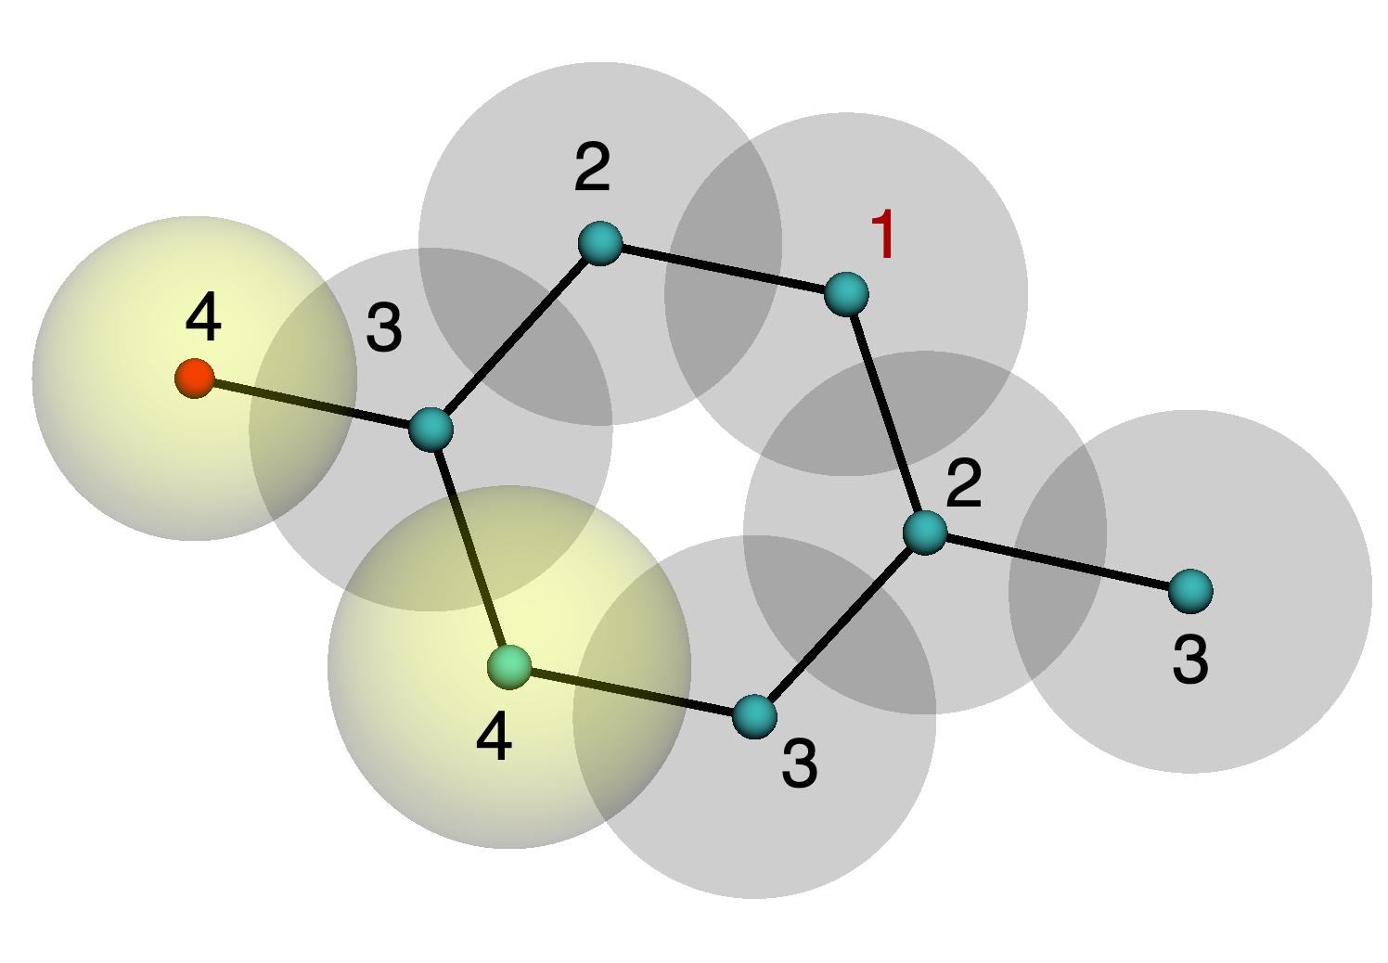
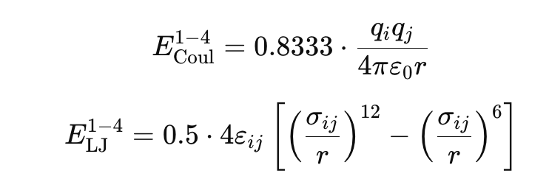
Non-Bonded: 1-4 interactions
In OpenMM:
<NonbondedForce coulomb14scale="0.8333333333333334" lj14scale=“0.5">
These scale the nonbonded interactions between 1–4 atoms (i.e., atoms separated by 3 bonds) to avoid double-counting with torsional interactions.
So for such pairs:
Electrostatic term is scaled by 0.8333
Lennard-Jones term is scaled by 0.5
That is:

Slide 17
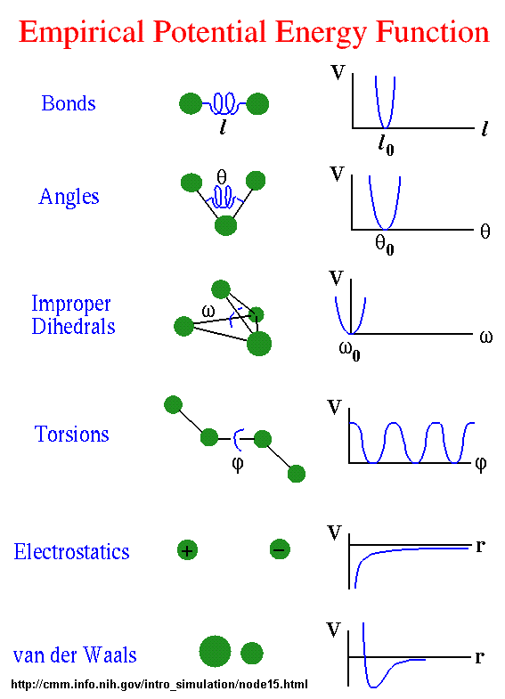
Force function profiles

